Slide 1

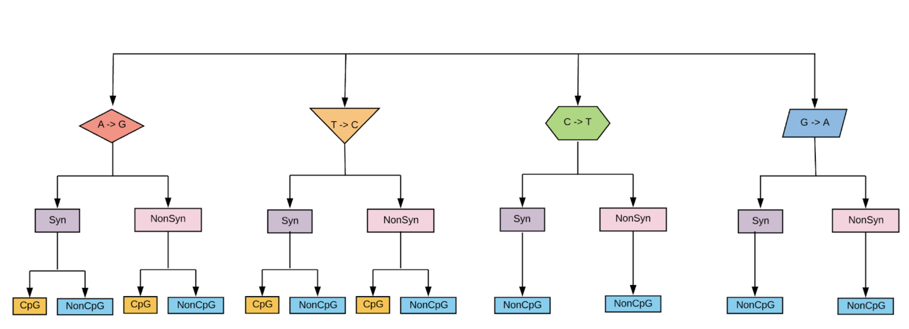
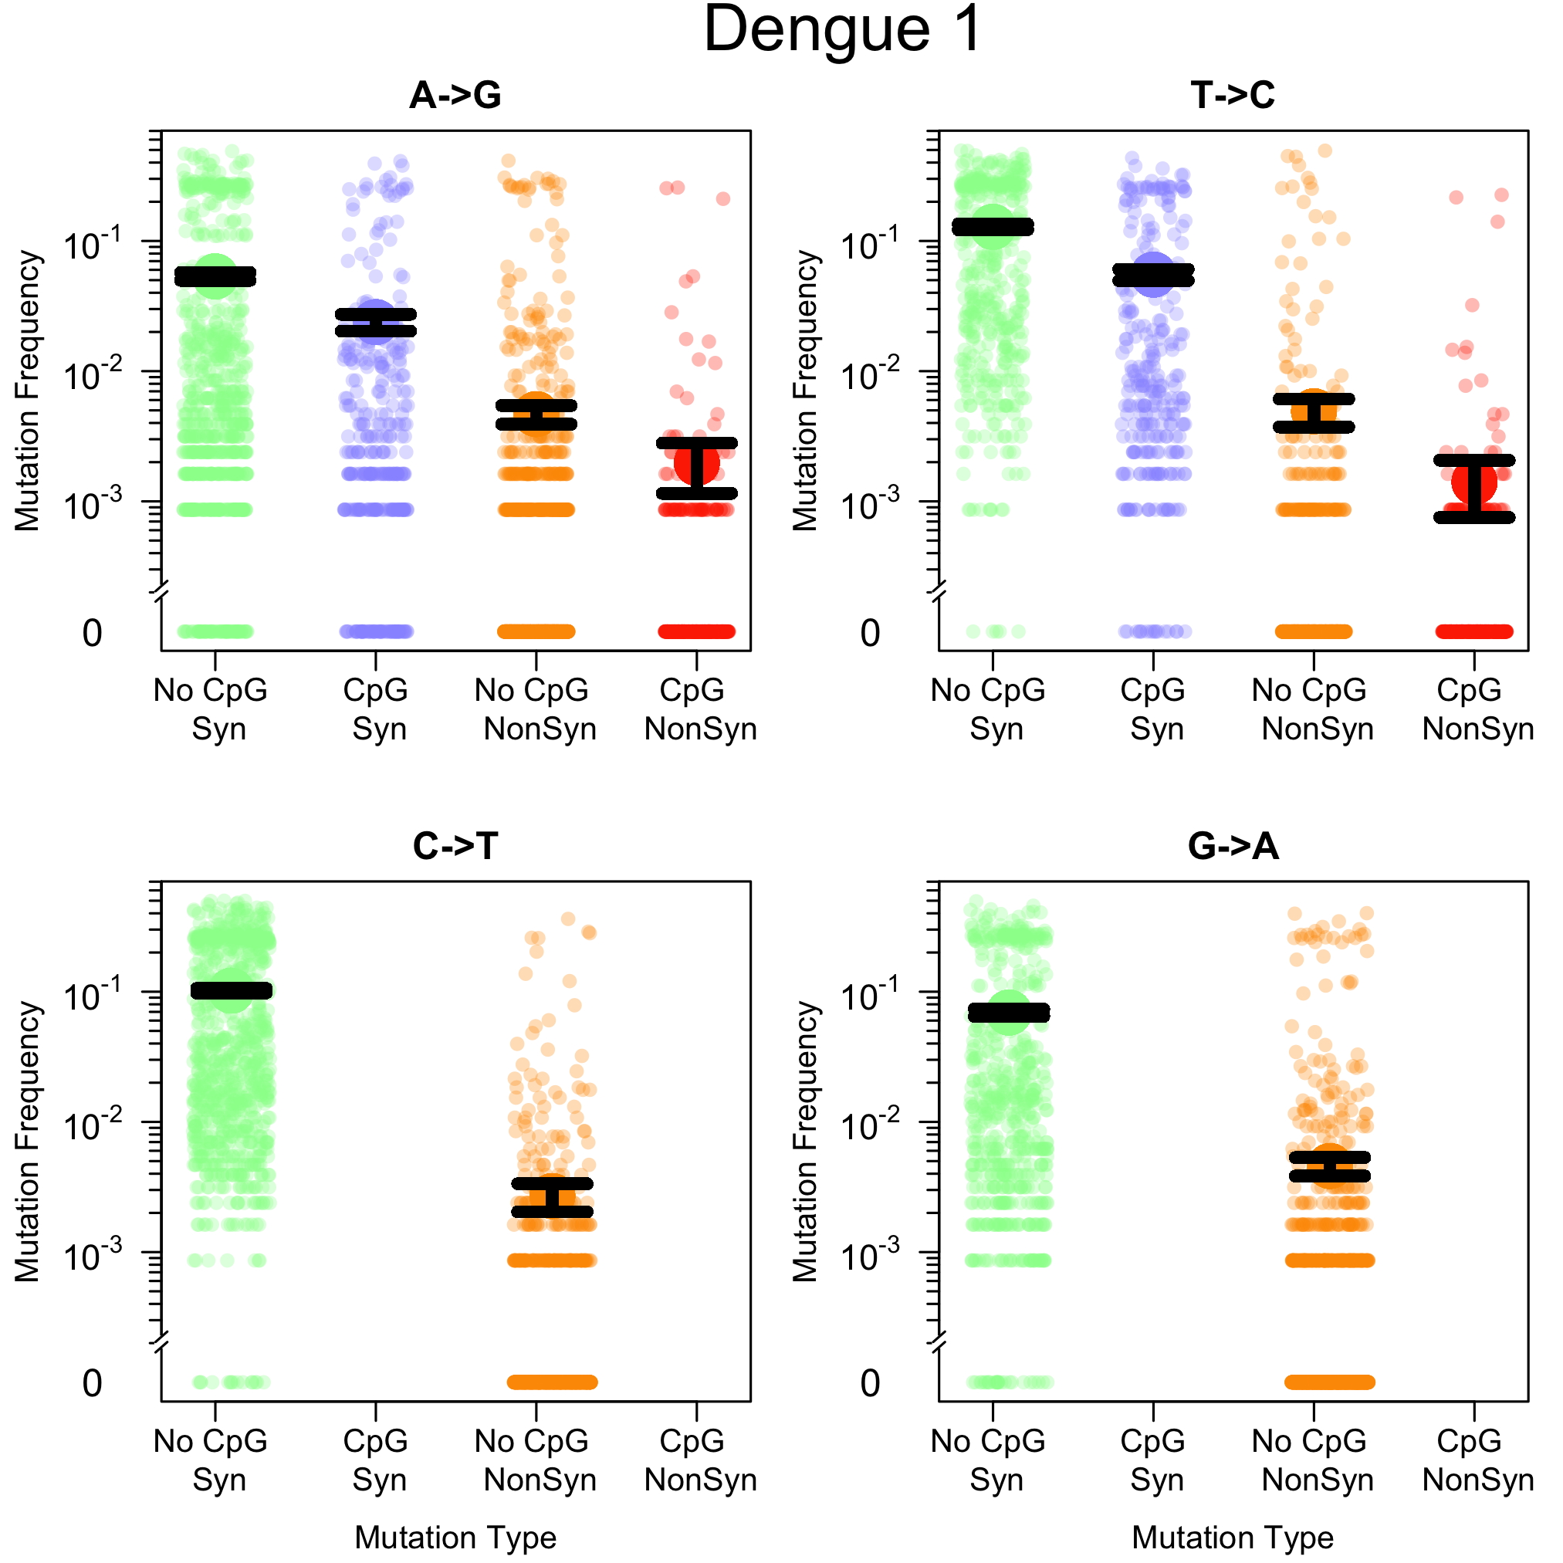
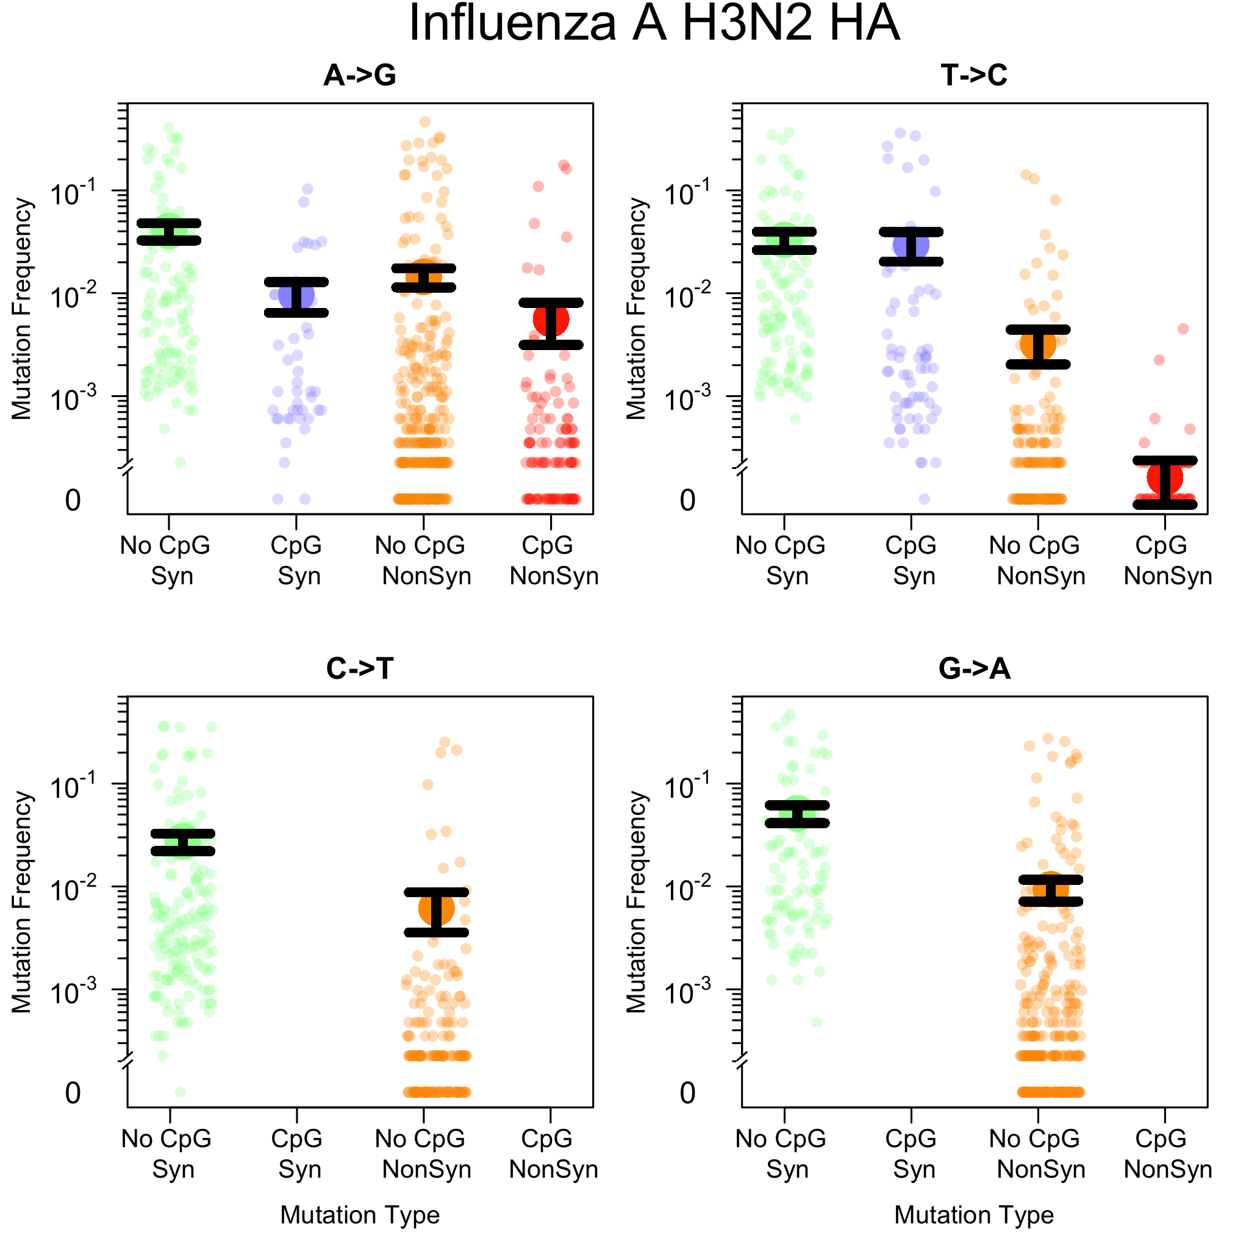
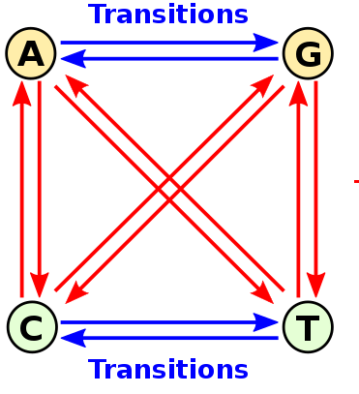
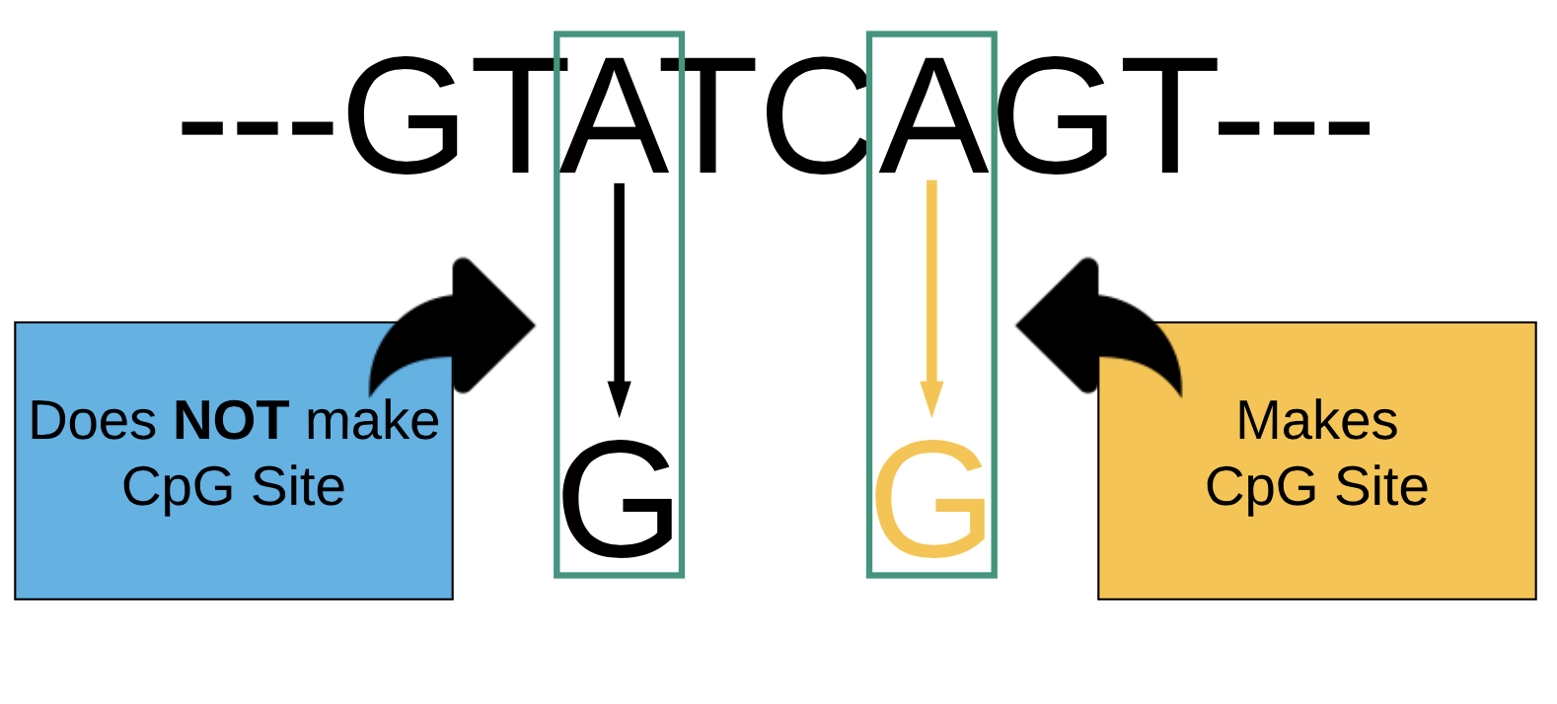

The Cost of CpG Mutations in Viruses
Victoria Caudill, Jasmeen Kaur, Sarina Qin, Ryan Winstead, Geo Pineda, Pleuni Pennings PhD.
Abstract
Methods
Discussion
Mutations can occur throughout the virus genome and may be beneficial or deleterious. Transition mutations switch a purine for a purine (A,G) or a pyrimidine for a pyrimidine (T,C). We are interested in mutations that yield a C next to a G producing CpG sites. It has been known for a long time that viruses have a lower occurrence of CpG sites. Previous HIV studies suggest CpG forming mutations have a negative effect on fitness when compared to other transition mutations; possibly due to suppression. To determine if this is the case in other viruses, we analyzed the cost of CpG forming mutations across various strains, subtypes, and genes. Our results support that CpG sites are costly for most viruses. By understanding the cost of CpG sites, we can obtain further insights into the evolution and adaptation of viruses.
Gathered virus sequences from GenBank
Found consensus sequences
Calculated Mutation frequency
Classify Mutations
Statistical Analysis using Wilcoxon Test
Calculated Costliness
The mutation frequencies seen in the results match our predictions that CpG sites are less frequent than non-CpG forming mutations. To validate our results, we used the same data and methods to demonstrate that synonymous mutations occur at a higher frequency than non-synonymous mutations.
The Wilcoxon test confirmed what was seen in the frequency graphs, by statistically quantifying the frequencies to determine the likelihood that this was a random incident. We observed that CpG mutations were occurring at lower frequencies and by comparing the mean frequencies we were able to determine how costly CpG sites are to viruses.
The reasons and levels of costliness varies, but it is clear that selection is occurring (keeping the amount of CpG sites down). A possible selection factor that could be acting upon these viruses is the Zinc Finger Antiviral Protein (ZAP protein) which is believed to target CpG sites. This targeting would explain the low amount of CpG sites detected in our datasets due to two reasons. One, the viruses have been detected and destroyed. Two, the viruses have come up with a mechanisms to limit the amount of A and T that could mutate into a CpG site.
To further study the costliness of CpG sites one could possibly induce these sites in viruses and measure their survival rates.
We separated types of mutations, categorized by synonymous and non-synonymous, and determined if a CpG or non-CpG site could form.
Results
CpG Creating Mutations are Costly for the Whole Genome of Dengue
CpG Creating Mutations are Costly for Hemagglutinin Protein in Influenza A
Background
In 1994 Karlin et al., found that a mutations resulting in a Cytosine positioned next to a Guanine (CpG) sites were underrepresented
in almost all small viruses
tested. CpG forming mutations
are not common in viruses
(Karlin et al., 1994), while the
overall process is not fully
understood, the lack of CpG
sites are potentially due to
suppression and/or selection.
Two potential CpG suppressors are the zinc-finger antiviral protein (ZAP) and the toll protein.
Taken from: https://en.wikipedia.org/wiki/Transition_(genetics)
CpG Creating Mutations are Costly for Most Viruses
References
1.Cuevas, J. M., Geller, R., Garijo, R., Lopez-Aldeguer, J. & Sanjuan, R. Extremely High Mutation Rate of HIV-1 In Vivo.PLoS Biol.13, e1002251 (2015).
2.Regoes, R. R., Bons, E. & Bertels, F. Estimating the mutational fitness effects distribution during early HIV infection.Virus Evol.4, DOI: 10.1093/ve/vey029 (2018). 3.Sanjuán, R., Moya, A. & Elena, S. F. The distribution of fitness effects caused by single-nucleotide substitutions in an rnavirus.Proc. Natl. Acad. Sci.101, 8396–8401, DOI: 10.1073/pnas.0400146101 (2004). https://www.pnas.org/content/101/
22/8396.full.pdf.
4.Duffy, S. Why are rna virus mutation rates so damn high?PLOS Biol.16, 1–6, DOI: 10.1371/journal.pbio.3000003 (2018).
5.Karlin, S. & Cardon, L. R. Computational dna sequence analysis.
Annu. Rev. Microbiol.48, 619–654, DOI: 10.1146/annurev.mi.48.100194.003155 (1994). PMID: 7826021, https://doi.org/10.1146/annurev.mi.48.100194.003155.
6.Takata, M. A.et al.CG dinucleotide suppression enables antiviral defence targeting non-self RNA.Nature550, 124–127(2017).
7.Takeshita, F.et al.Cutting edge: Role of toll-like receptor 9 in cpg dna-induced activation of human cells.The J. Immunol.167
, 3555–3558, DOI: 10.4049/jimmunol.167.7.3555 (2001). http://www.jimmunol.org/content/167/7/3555.full.pdf.
8.Theys, K.et al.Correction: Within-patient mutation frequencies reveal fitness costs of CpG dinucleotides and drasticamino acid changes in HIV.PLoS Genet.14, e1007855 (2018).
9.Team, S. W. Sib expasy bioformatics resources portal (1993).
10.Yu, G., Smith, D. K., Zhu, H., Guan, Y. & Lam, T. T.-Y. ggtree: an r package for visualization and annotation of phylogenetictrees with their covariates andother associated data.Methods Ecol. Evol.8, 28–36, DOI: 10.1111/2041-210X.12628(2017).
11.Burns, C. C.et al.Genetic inactivation of poliovirus infectivity by increasing the frequencies of CpG and UpA dinucleotideswithin and across synonymouscapsid region codons.J. Virol.83, 9957–9969 (2009).
12.R Development Core Team.R: A Language and Environment for Statistical Computing. R Foundation for StatisticalComputing, Vienna, Austria (2008). ISBN 3-900051-07-0.
Acknowledgments
Special thanks to fall 2017 bioinformatics (biol638/738), SFSU Biology Department, Computer Science Department and the College of Science and Engineering (COSE). Members of the NESCENT working group on human viruses contributed to this work (Rustom Antia, Trevor Bedford, Nacho Bravo, Oana Carja, Sarah Cobey, Rosalind Eggo, Elodie Ghedin, Katia Koelle, Katrina Lythgoe, Roland Regoes, Veronika Zarnitsyna). Funded by NSF grant # 1655212
ZAP
Taken from: https://www.teepublic.com/t-shirts/bacteria

